Slide 1
Chapter 1: Introduction

Slide 2
Outline
The Need for Databases
Data Models
Relational Databases
Database Design
Storage Manager
Query Processing
Transaction Manager

Slide 3
Database Management System (DBMS)
DBMS contains information about a particular enterprise
  Collection of interrelated data
  Set of programs to access the data
  An environment that is both convenient and efficient to use
Database Applications:
  Banking: transactions
  Airlines: reservations, schedules
  Universities: registration, grades
  Sales: customers, products, purchases
  Online retailers: order tracking, customized recommendations
  Manufacturing: production, inventory, orders, supply chain
  Human resources: employee records, salaries, tax deductions
Databases can be very large.
Databases touch all aspects of our lives

Slide 4
University Database Example
Application program examples
  Add new students, instructors, and courses
  Register students for courses, and generate class rosters
  Assign grades to students, compute grade point averages (GPA) and generate transcripts
In the early days, database applications were built directly on top of file systems

Slide 5
Drawbacks of using file systems to store data
Data redundancy and inconsistency
  Multiple file formats, duplication of information in different files
Difficulty in accessing data
  Need to write a new program to carry out each new task
Data isolation
  Multiple files and formats
Integrity problems
  Integrity constraints (e.g., account balance > 0) become “buried” in program code rather than being stated explicitly
  Hard to add new constraints or change existing ones

Slide 6
Drawbacks of using file systems to store data (Cont.)
Atomicity of updates
  Failures may leave database in an inconsistent state with partial updates carried out
  Example: Transfer of funds from one account to another should either complete or not happen at all
Concurrent access by multiple users
  Concurrent access needed for performance
  Uncontrolled concurrent accesses can lead to inconsistencies
    Example: Two people reading a balance (say 100) and updating it by withdrawing money (say 50 each) at the same time
Security problems
  Hard to provide user access to some, but not all, data
Database systems offer solutions to all the above problems

Slide 7
Levels of Abstraction
Physical level: describes how a record (e.g., instructor) is stored.
Logical level: describes data stored in database, and the relationships among the data.
  type instructor = record
  ID : string;
  name : string;
  dept_name : string;
  salary : integer;
        end;
View level: application programs hide details of data types. Views can also hide information (such as an employee’s salary) for security purposes.

Slide 8

View of Data
An architecture for a database system

Slide 9
DBMS Environment
Hardware
  Client-server architecture
Software
  dbms, os, network, application
Data
  Schema, subschema, table, attribute
People
  Data administrator & database administrator
  Database designer: logical & physical
  Application programmer
  End-user: naive & sophisticated
Procedure
  Start, stop, log on, log off, back up, recovery

Slide 10
Instances and Schemas
Similar to types and variables in programming languages
Logical Schema – the overall logical structure of the database
  Example: The database consists of information about a set of customers and accounts in a bank and the relationship between them
    Analogous to type information of a variable in a program
Physical schema– the overall physical structure of the database
Instance – the actual content of the database at a particular point in time
  Analogous to the value of a variable
Physical Data Independence – the ability to modify the physical schema without changing the logical schema
  Applications depend on the logical schema
  In general, the interfaces between the various levels and components should be well defined so that changes in some parts do not seriously influence others.

Slide 11
History of Database Systems
First generation
  Hierarchical model
    Information Management System (IMS)
  Network model
    Conference on Data System Languages (CODASYL)
    Data Base Task Group (DBTG)
  Limitation
    Complex program for simple query
    Minimum data independence
    No theoretical foundation
Second generation
  Relational model
    E. R. Codd
    DB2, Oracle
  Limitation
    Limited data modeling
Third generation
  Object-relational DBMS
  Object-oriented DBMS

Slide 12
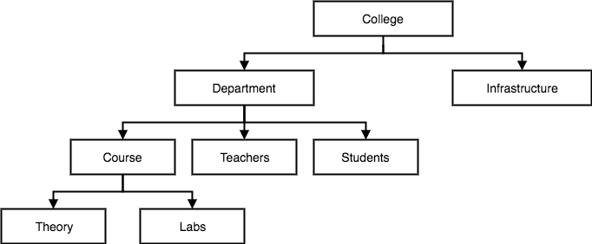
Hierarchical Model
Data is organised into a tree-like-structure
  a single root, to which all the other data is linked.
  adding child nodes to the parent nodes.
a child node will only have a single parent node.
E.g.real-world relationships like index of a book, recipes etc.
data is organised into tree-like structure with one one-to-many relationship between two different types of data,
  E.g. one department can have many courses, many professors and of-course many students.

Slide 13
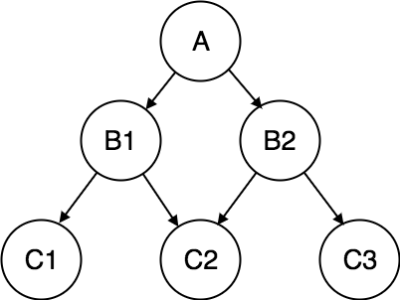
Network Model
Extension of the Hierarchical model.
Data is organised more like a graph, and are allowed to have more than one parent node.
Data is more related as more relationships are established
Accessing the data is also easier and fast.
Map many-to-many data relationships.
Most widely used database model, before Relational Model was introduced.

Slide 14
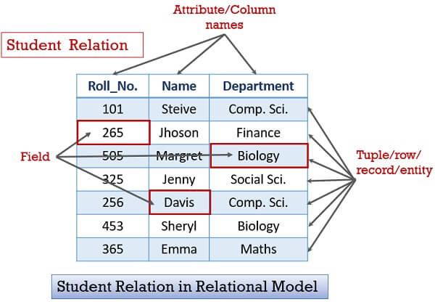
Relational Model
set of relations (table of values).
Each relation has columns (attributes) and rows(Tuples)

Slide 15
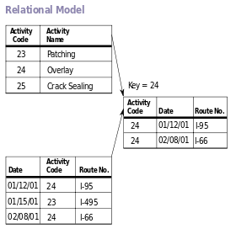
Relational Model Example

Slide 16
Object Oriented Model
Real world situations are represented as objects, with different attributes.
All these object have multiple relationships between them.
Elements of Object oriented data model
Objects
  The real world entities and situations are represented as objects in the Object oriented database model.
Attributes and Method
  Every object has certain characteristics. These are represented using Attributes. The behaviour of the objects is represented using Methods.
Class
  Similar attributes and methods are grouped together using a class. An object can be called as an instance of the class.
Inheritance
  A new class can be derived from the original class. The derived class contains attributes and methods of the original class as well as its own.
Example
An Example of the Object Oriented data model is −

Slide 17
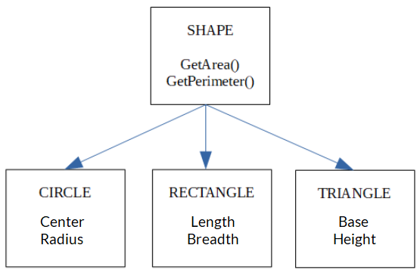
Object Oriented Model
Example
Objects : Shape, Circle, Rectangle and Triangle
Attributes : Center and Radius : Circle etc.
The objects Circle, Rectangle and Triangle inherit from the object Shape.

Slide 18
Object-Relational Data Models
Relational model: flat, “atomic” values
Object Relational Data Models
  Extend the relational data model by including object orientation and constructs to deal with added data types.
  Allow attributes of tuples to have complex types, including non-atomic values such as nested relations.
  Preserve relational foundations, in particular the declarative access to data, while extending modeling power.
  Provide upward compatibility with existing relational languages.

Slide 19
Object Relational Model
Combination of a Object oriented database model and a Relational database model.
Supports objects, classes, inheritance etc. just like Object Oriented models and has support for data types, tabular structures etc. like Relational data model.
Advantages
  Inheritance : allows its users to inherit objects, tables etc. to extend their functionality.
    Inherited objects contains new attributes as well as the attributes that were inherited.
  Complex Data Types : Formed using existing data types.
    This is useful in Object relational data model as complex data types allow better manipulation of the data.
  Extensibility : The functionality can be extended using complex data types as well as advanced concepts of object oriented model such as inheritance.
Disadvantages
  Complicated and difficult to handle

Slide 20
Language: SQL
The most widely used commercial language
SQL is NOT a Turing machine equivalent language
To be able to compute complex functions SQL is usually embedded in some higher-level language
Application programs generally access databases through one of
  Language extensions to allow embedded SQL
  Application program interface (e.g., ODBC/JDBC) which allow SQL queries to be sent to a database

Slide 21
Data Definition Language (DDL)
Specification notation for defining the database schema
  Example: create table instructor {
  ID char(5),
  name varchar(20),
  dept_name varchar(20),
  salary numeric(8,2) };
DDL compiler generates a set of table templates stored in a data dictionary
Data dictionary contains metadata (i.e., data about data)
  Database schema
  Integrity constraints
    Primary key (ID uniquely identifies instructors)
  Authorization
    Who can access what

Slide 22
Data Manipulation Language (DML)
Language for accessing and manipulating the data organized by the appropriate data model
  DML also known as query language
Two classes of languages
  Pure – used for proving properties about computational power and for optimization
    Relational Algebra
    Tuple relational calculus
    Domain relational calculus
  Commercial – used in commercial systems
    SQL is the most widely used commercial language

Slide 23
XML: Extensible Markup Language
Defined by the WWW Consortium (W3C)
Originally intended as a document markup language not a database language
The ability to specify new tags, and to create nested tag structures made XML a great way to exchange data, not just documents
XML has become the basis for all new generation data interchange formats.
A wide variety of tools is available for parsing, browsing and querying XML documents/data

Slide 24
Database Design
The process of designing the general structure of the database:
Logical Design – Deciding on the database schema. Database design requires that we find a “good” collection of relation schemas.
  Business decision – What attributes should we record in the database?
  Computer Science decision – What relation schemas should we have and how should the attributes be distributed among the various relation schemas?
Physical Design – Deciding on the physical layout of the database

Slide 25

Database Design (Cont.)
Is there any problem with this relation?

Slide 26
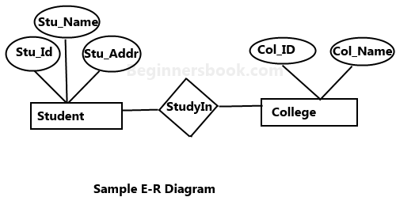
Design Approaches
Need to come up with a methodology to ensure that each of the relations in the database is “good”
Two ways of doing so:
  Entity Relationship Model
    Models an enterprise as a collection of entities and relationships
    Represented diagrammatically by an entity-relationship diagram:
  Normalization Theory
    Formalize what designs are bad, and test for them

Slide 27
Database Engine
Storage manager
Query processing
Transaction manager

Slide 28
Storage Management
Storage manager is a program module that provides the interface between the low-level data stored in the database and the application programs and queries submitted to the system.
The storage manager is responsible to the following tasks:
  Interaction with the OS file manager
  Efficient storing, retrieving and updating of data
Issues:
  Storage access
  File organization
  Indexing and hashing

Slide 29

Query Processing
1. Parsing and translation
2. Optimization
3. Evaluation

Slide 30
Query Processing (Cont.)
Alternative ways of evaluating a given query
  Equivalent expressions
  Different algorithms for each operation
Cost difference between a good and a bad way of evaluating a query can be enormous
Need to estimate the cost of operations
  Depends critically on statistical information about relations which the database must maintain
  Need to estimate statistics for intermediate results to compute cost of complex expressions

Slide 31
Transaction Management
What if the system fails?
What if more than one user is concurrently updating the same data?
A transaction is a collection of operations that performs a single logical function in a database application
Transaction-management component ensures that the database remains in a consistent (correct) state despite system failures (e.g., power failures and operating system crashes) and transaction failures.
Concurrency-control manager controls the interaction among the concurrent transactions, to ensure the consistency of the database.

Slide 32

Database Users and Administrators
Database

Slide 33

Database System Internals

Slide 34
Database Architecture
The architecture of a database systems is greatly influenced by
the underlying computer system on which the database is running:
Centralized
Client-server
Parallel (multi-processor)
Distributed

Slide 35
Advantages of DBMS
Control redundancy
Consistency
Integrity
Security
Concurrency control
Backup & recovery
Data standard
More information
Data sharing & conflict control
Productivity & accessibility
Economy of scale
Maintenance

Slide 36
Limitations of DBMS
Complexity
Size
Cost
  Software
  Hardware
  Conversion
Performance
Vulnerability

